Slide 1
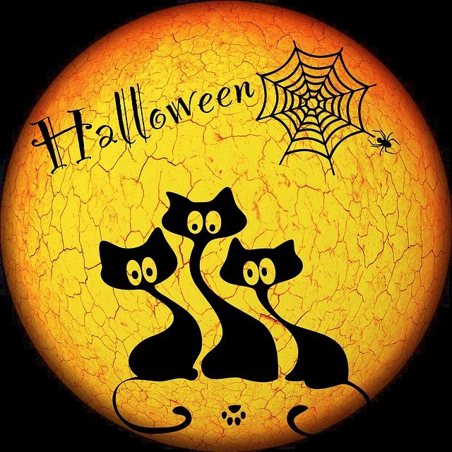
Halloween Spook-tacular
Keep watching if you dare to see all our spooky art work….

Slide 2
Beware the junior infant corridor....

Slide 3
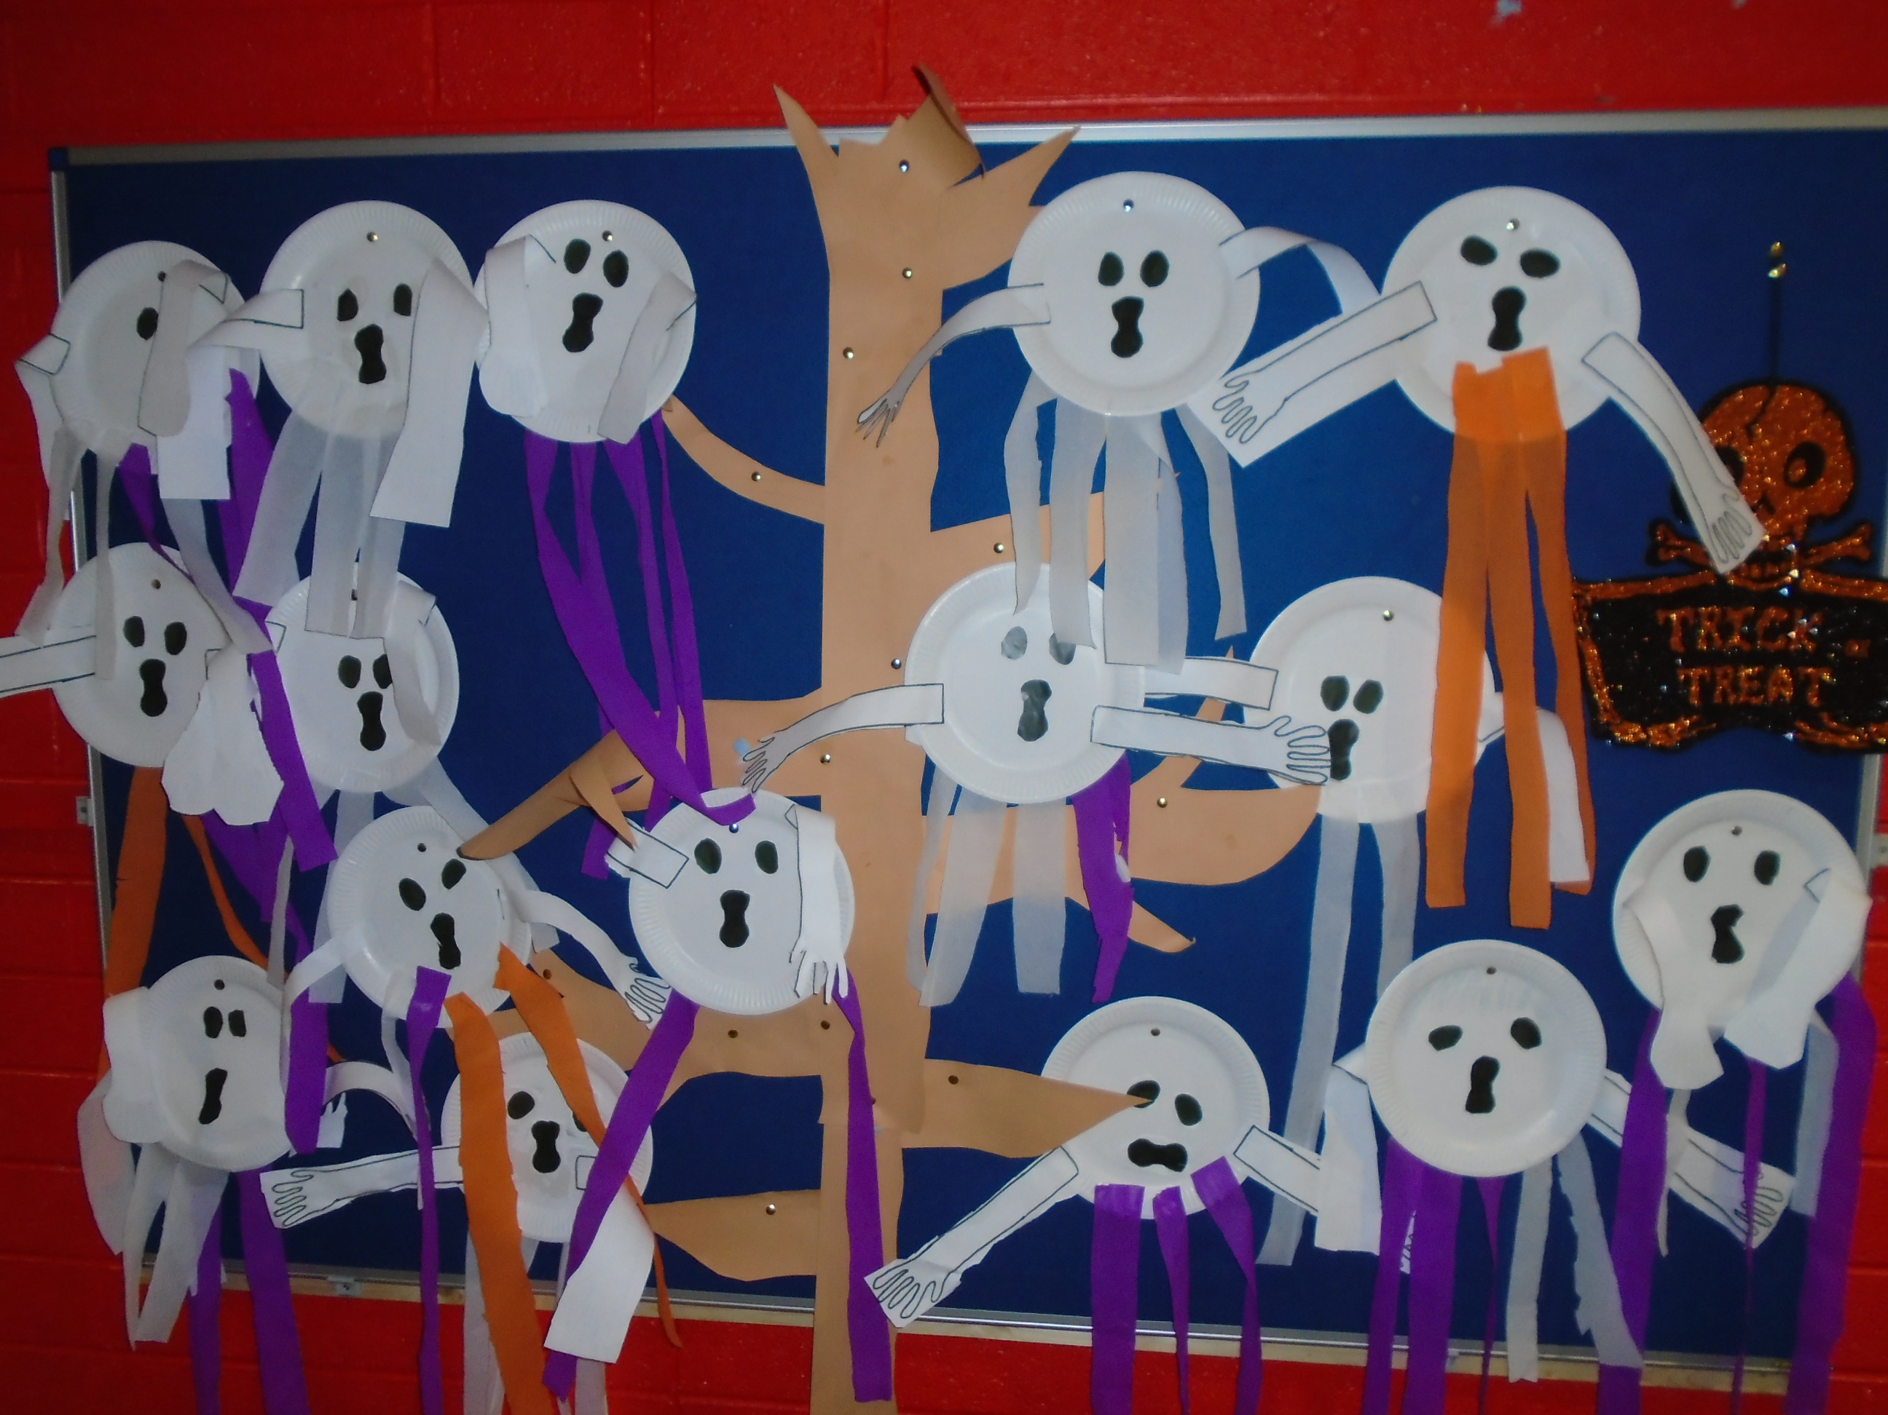
Look who’s hanging out in senior infants…

Slide 4
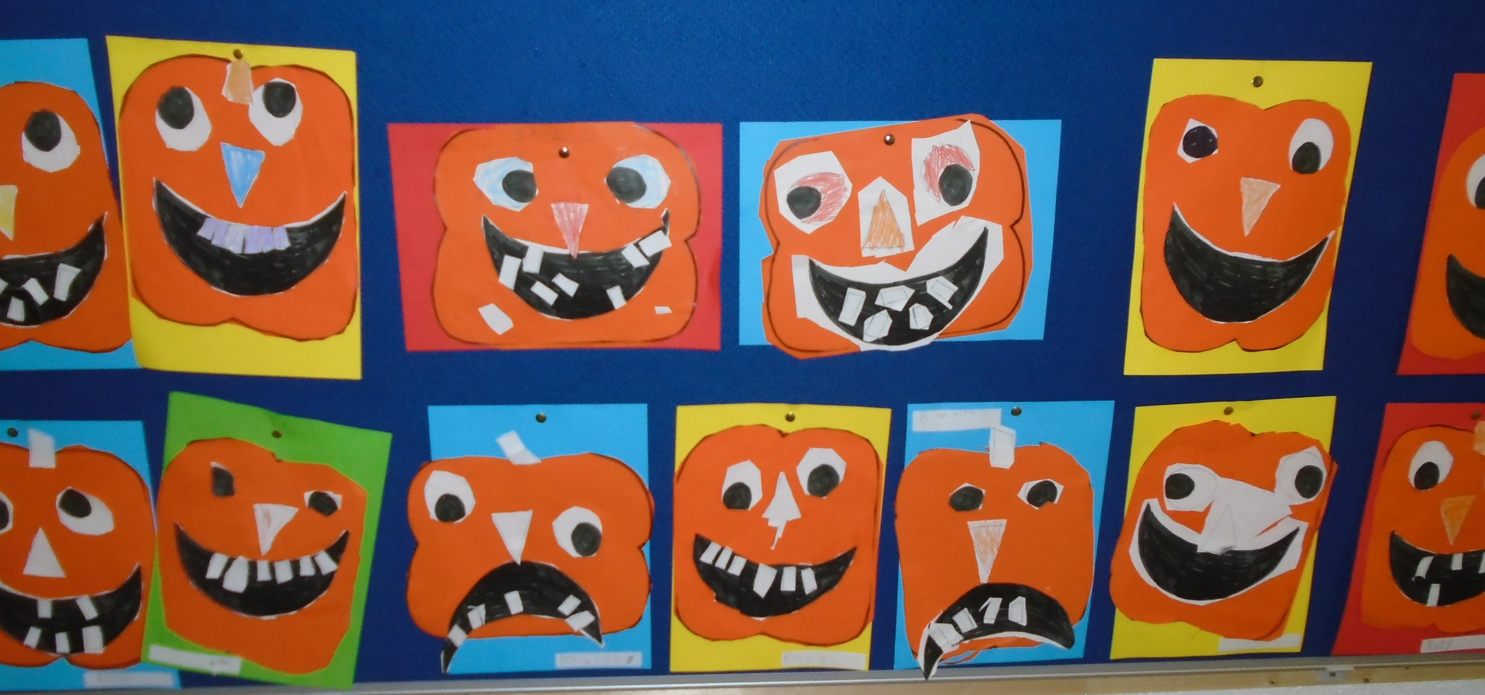
…along with these crazy pumpkins

Slide 5
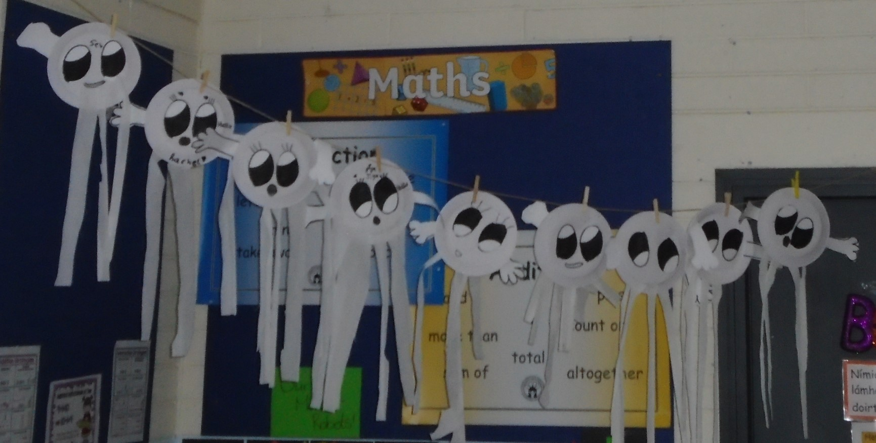
Some ghostly creatures have moved in…

Slide 6
and some witches are flying by Martina’s1st class…

Slide 7
Happy Halloween from Andrea’s 1st Class…

Slide 8
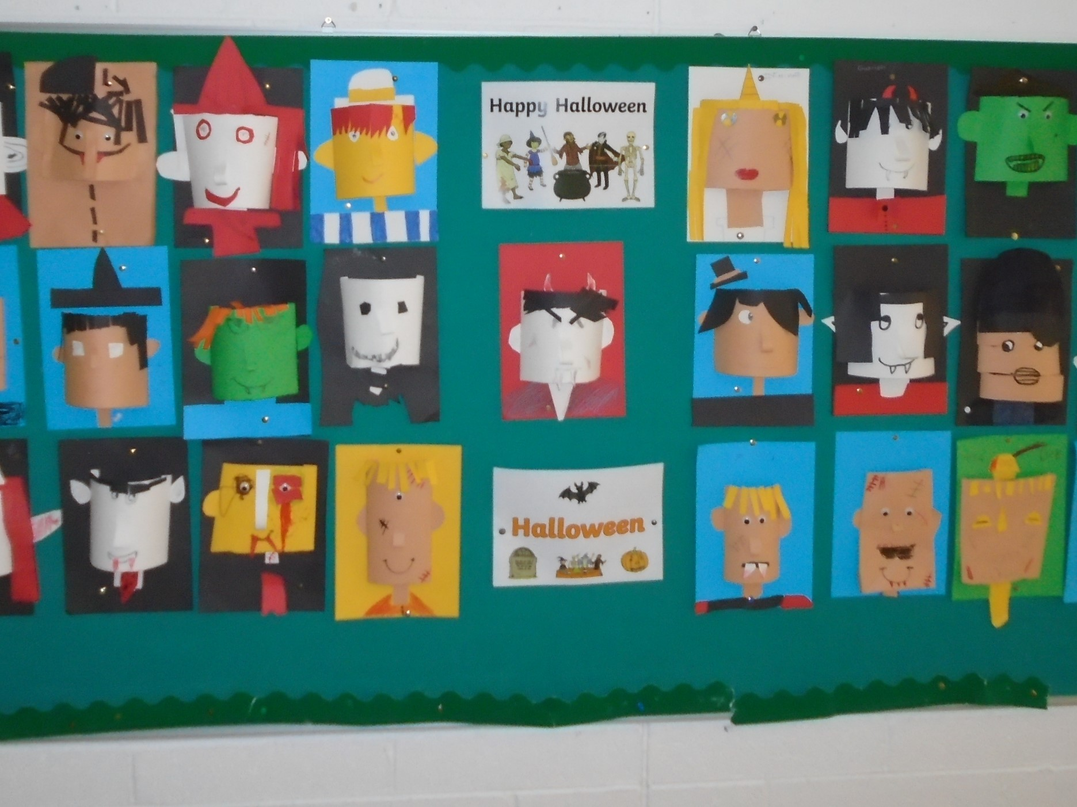
Cats, bats and scary monsters await you at Claire’s 2nd class…

Slide 9
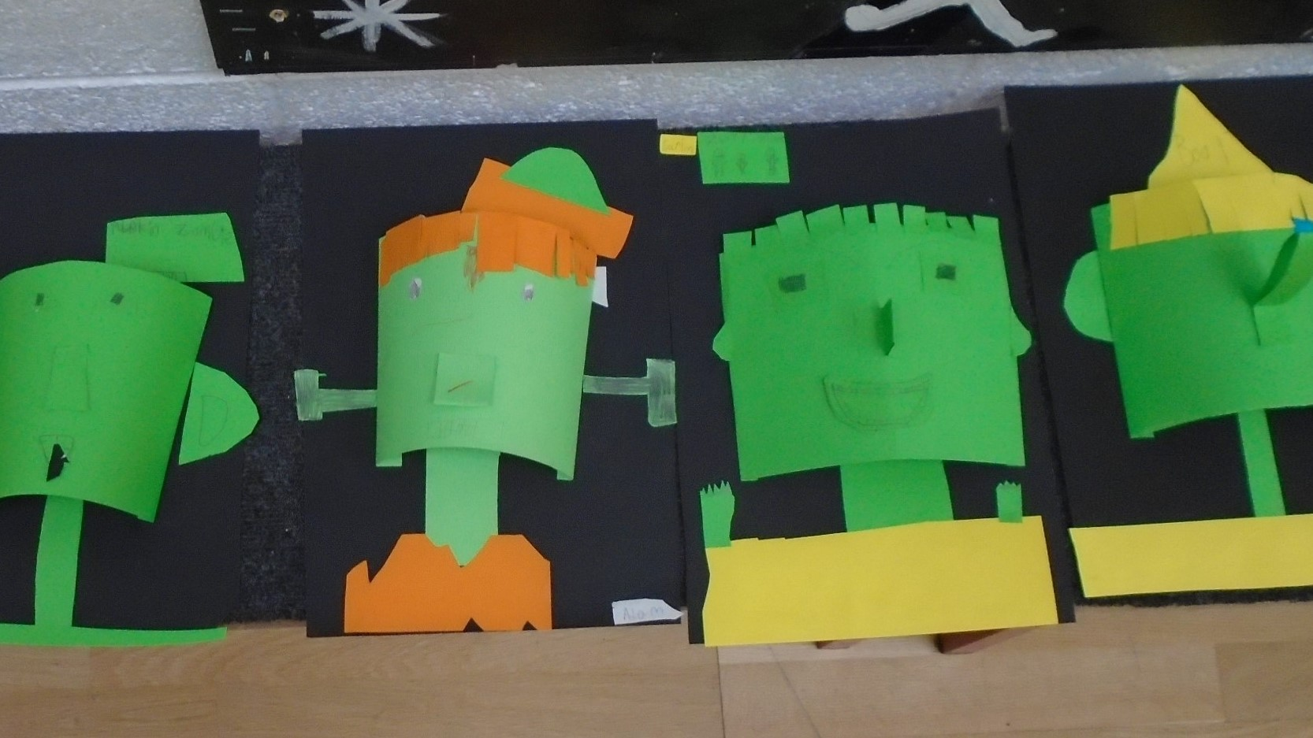
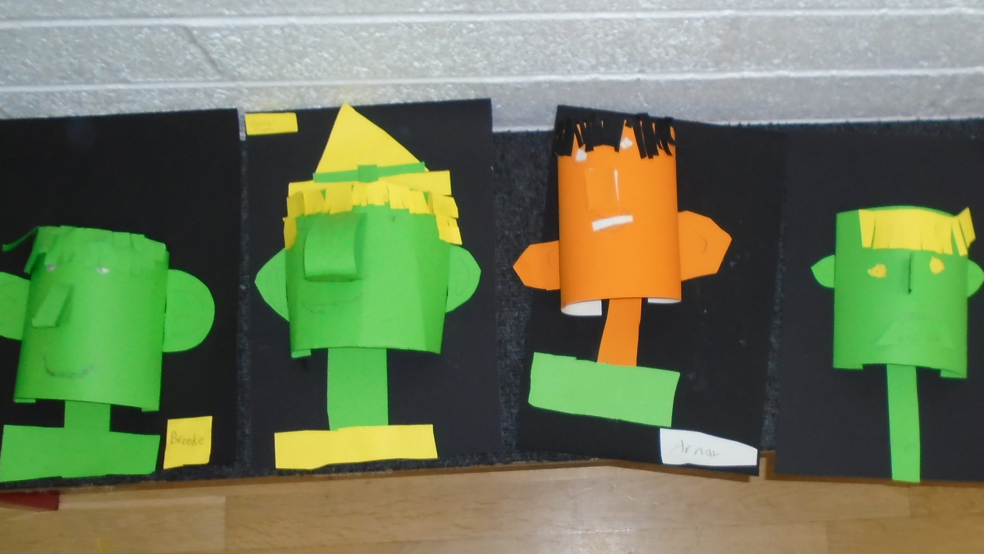
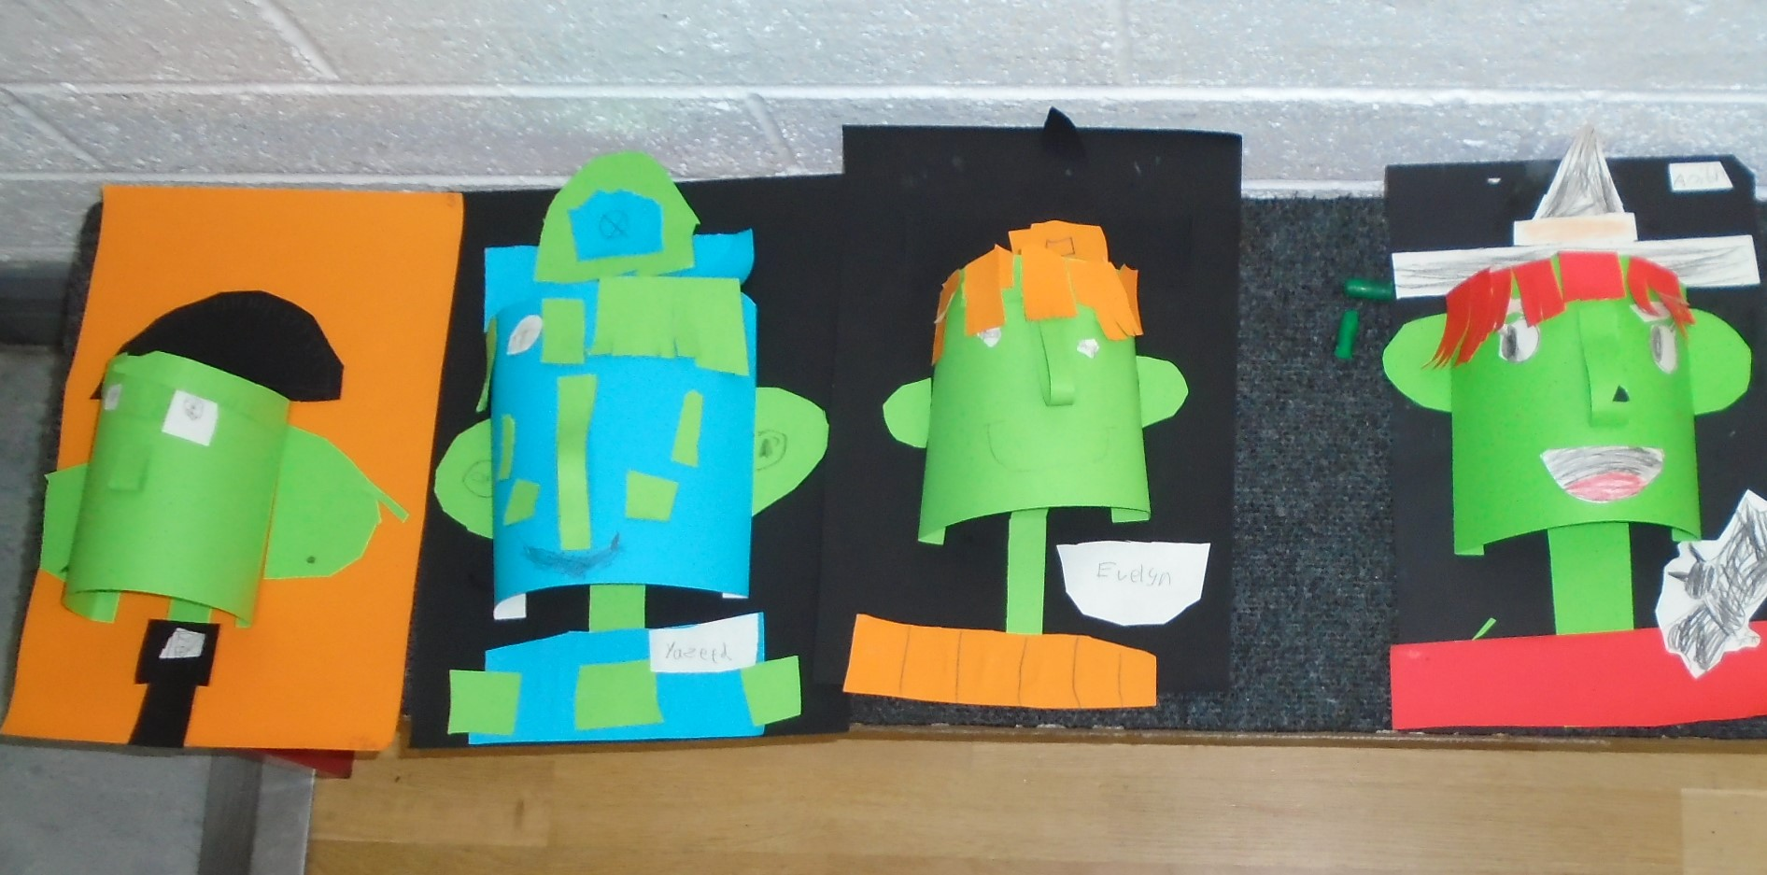
Meet Dr. Frankenstein’s Monsters in Deirdre’s 2nd class…

Slide 10
Púca agus Vaimpír i Sharon’s ranga 3…

Slide 11
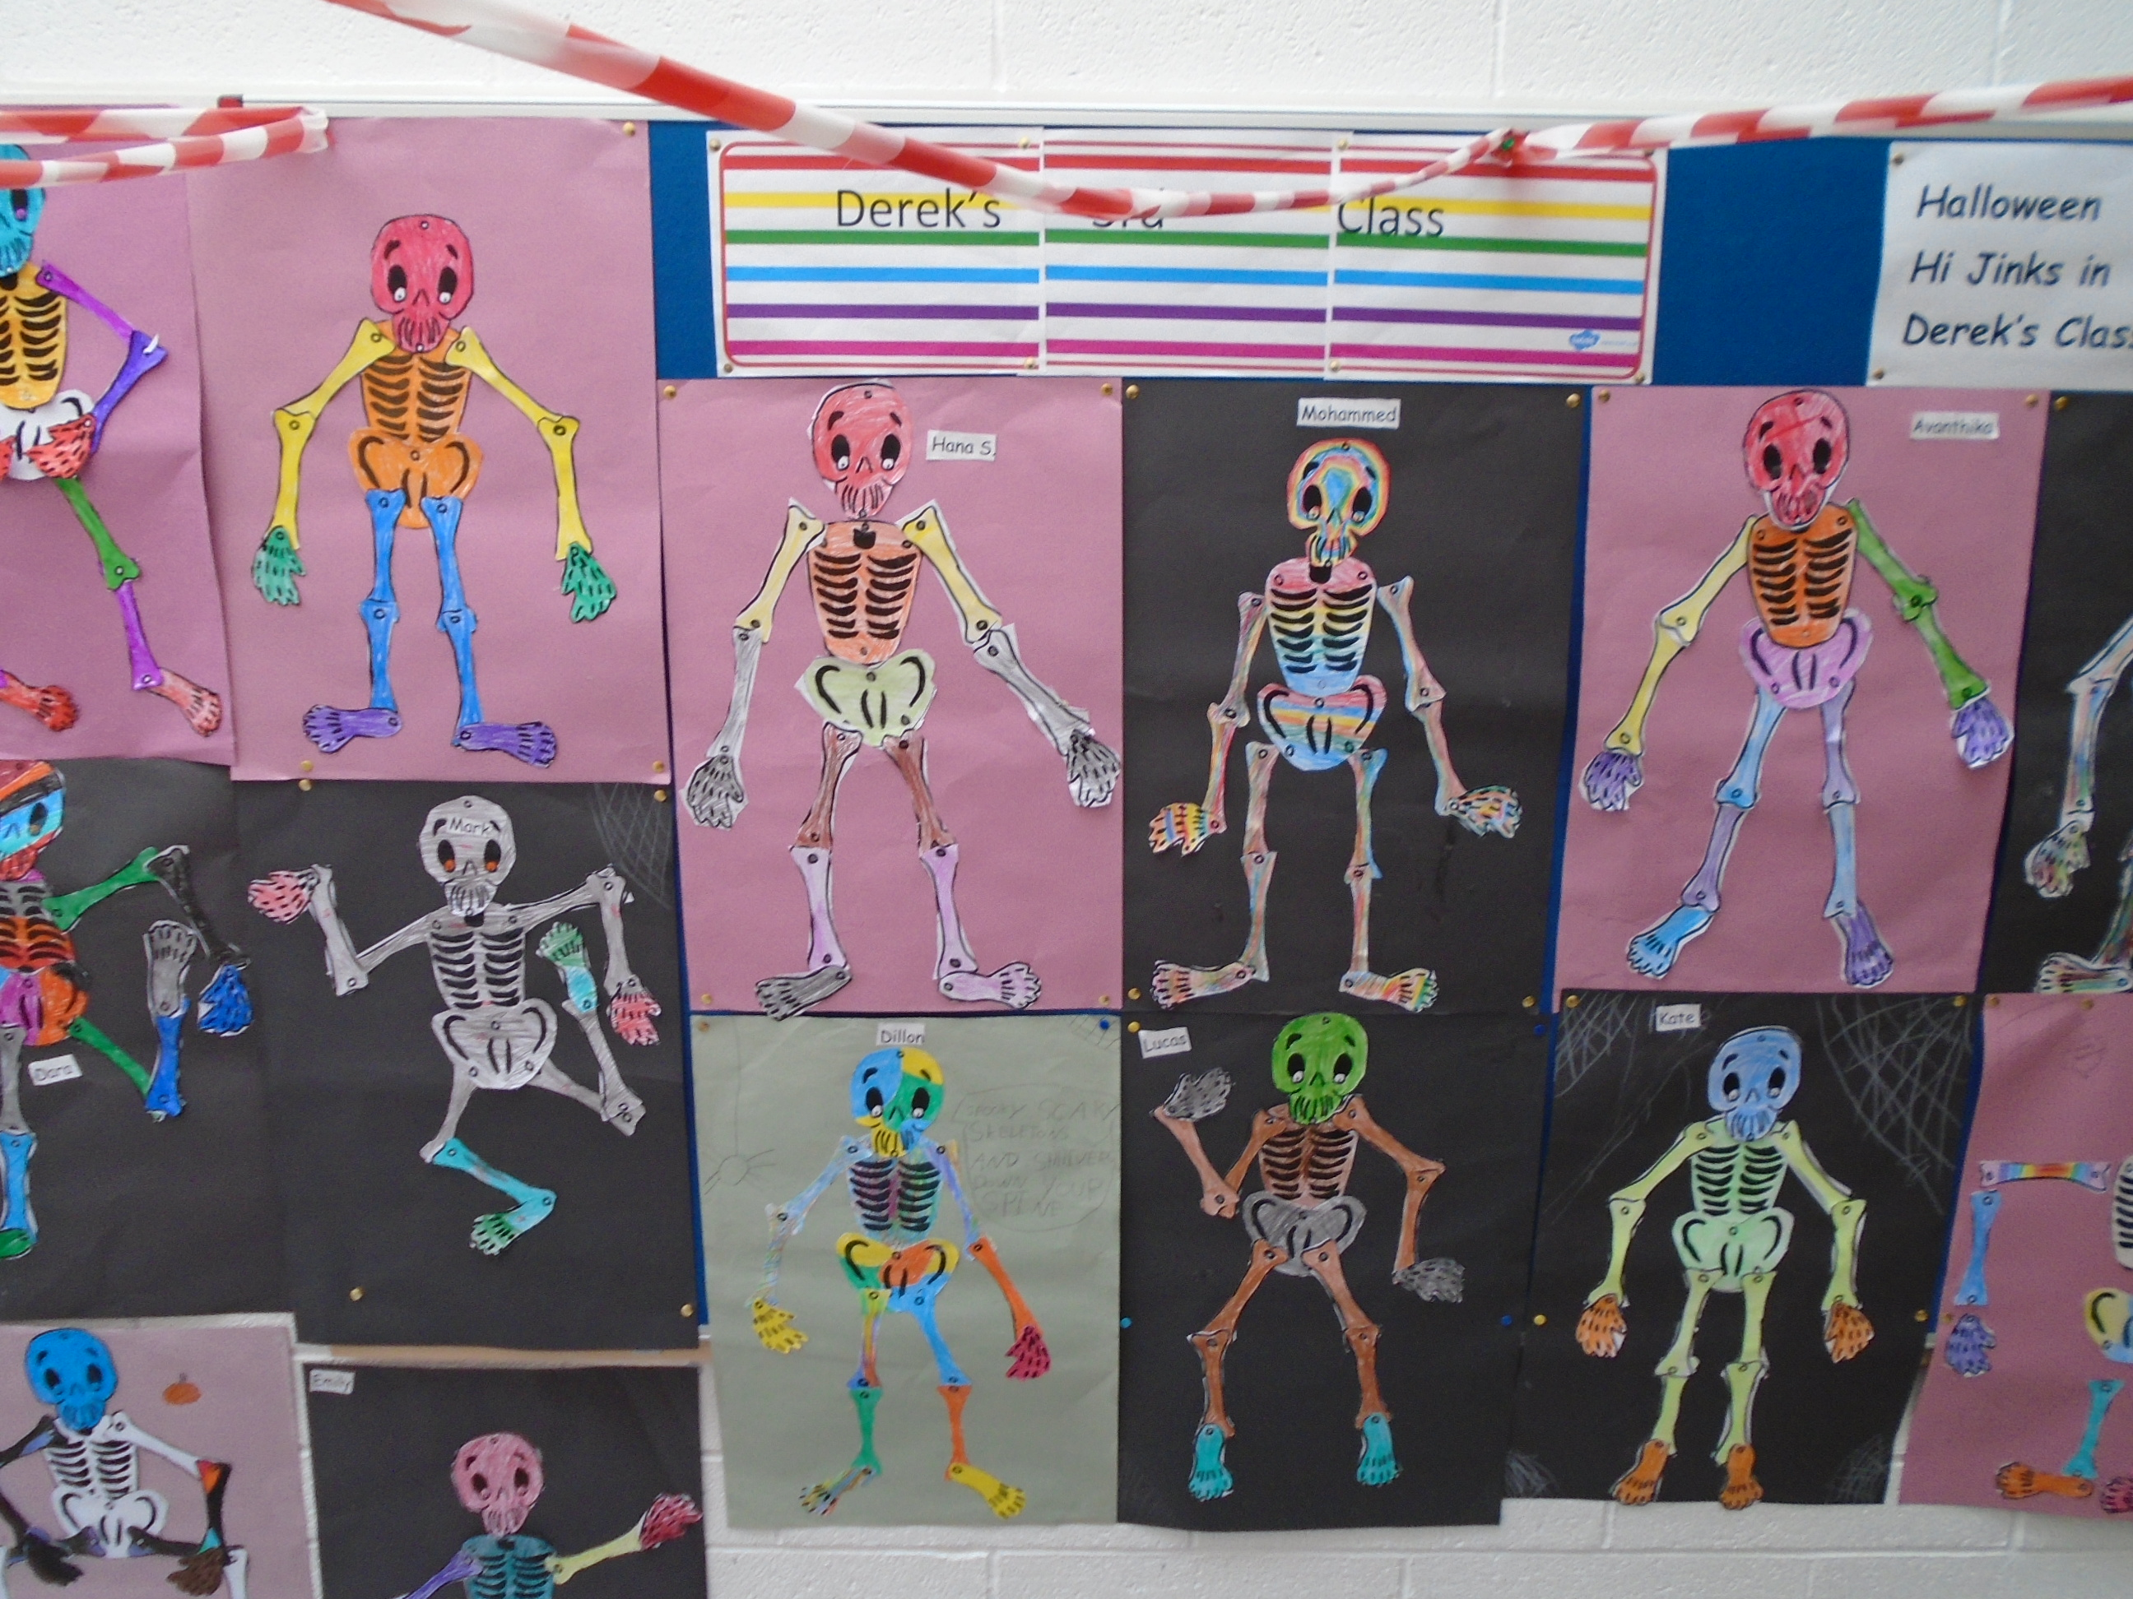
Some dancing skeletons await you in Derek’s 3rd class…

Slide 12
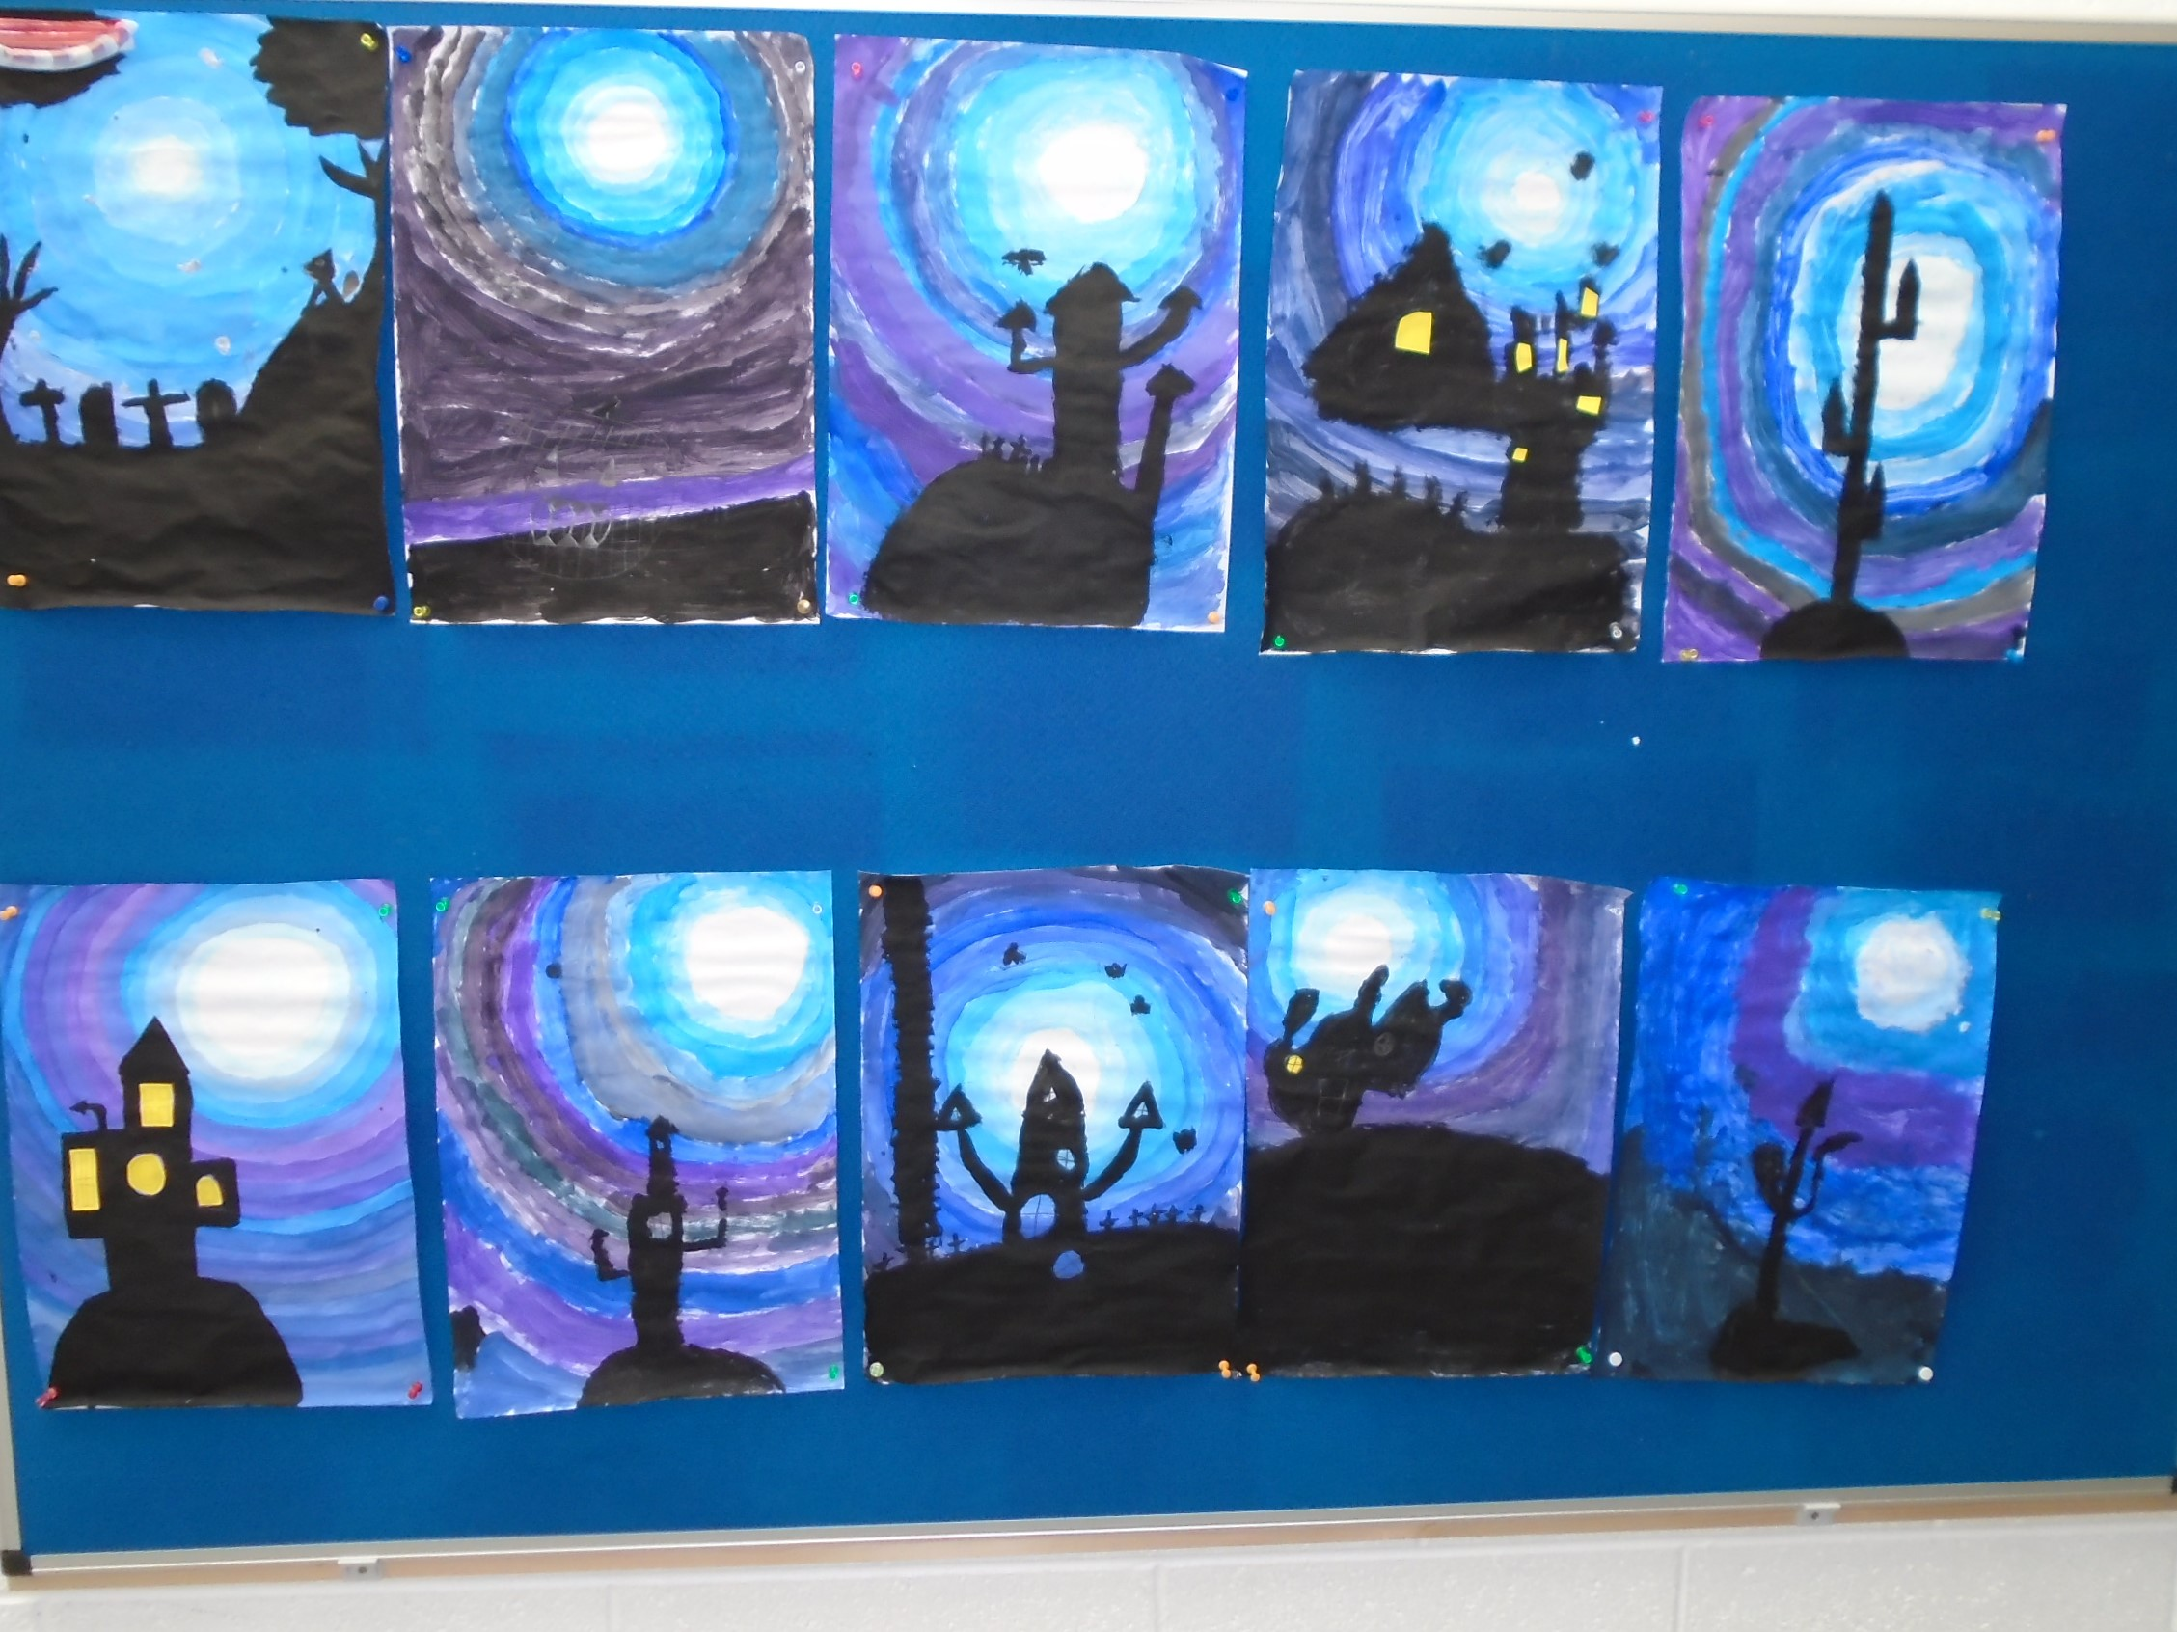
Visit the haunted mansion’s in Sarah’s 4th class…

Slide 13
Watch out for flying bats outside Muireann’s 4th class…

Slide 14
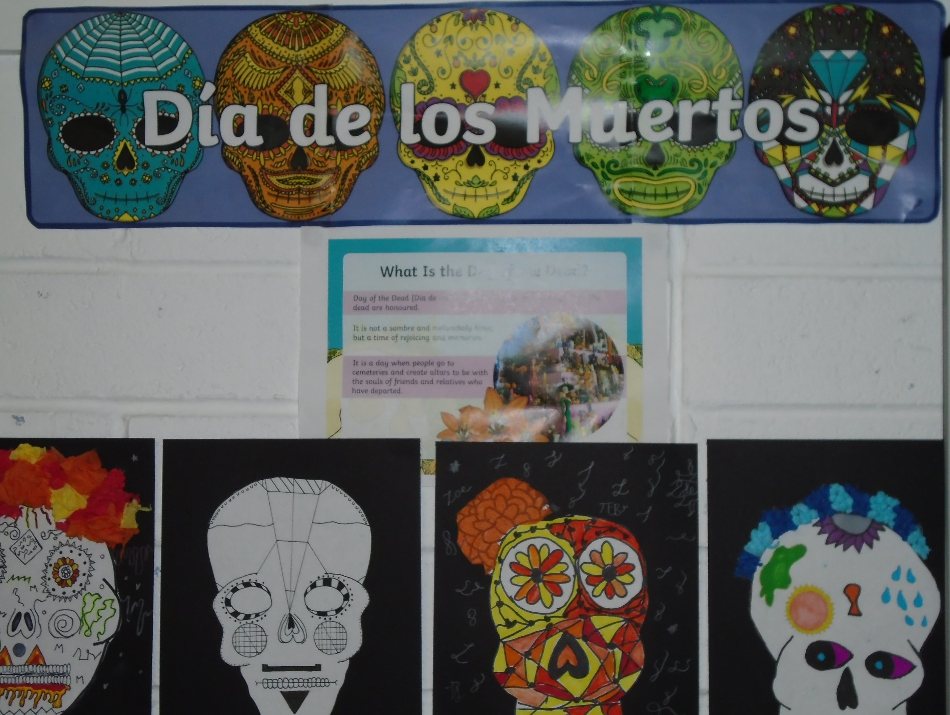
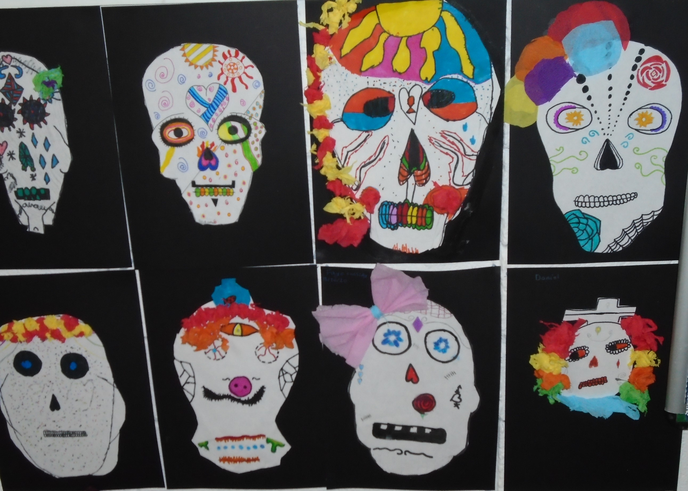
Grace’s 5th class are celebrating Día de los Muertos – The Day of the Dead…

Slide 15
Watch out for the colony of bats flying passed Therese’s 6th class…

Slide 16
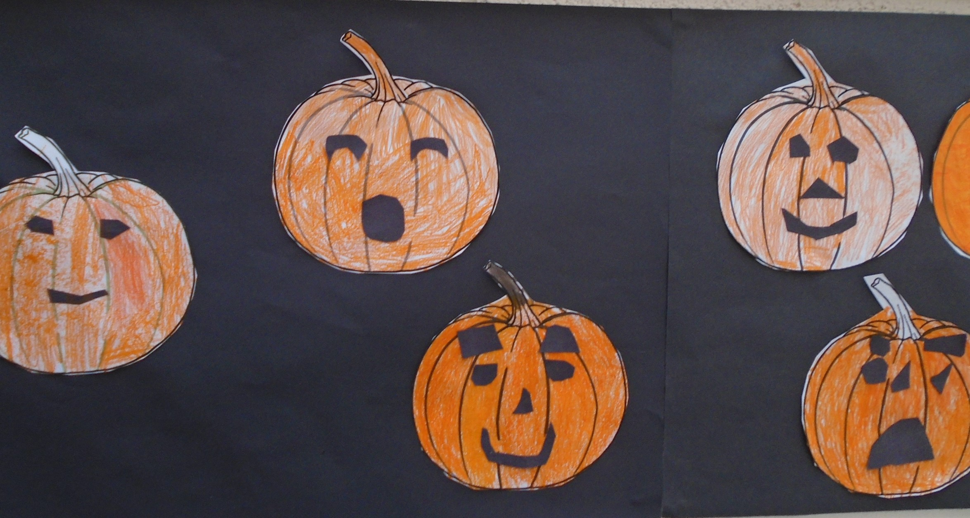
Ian’s class have some wonderful ideas for pumpkin carving…

Slide 17
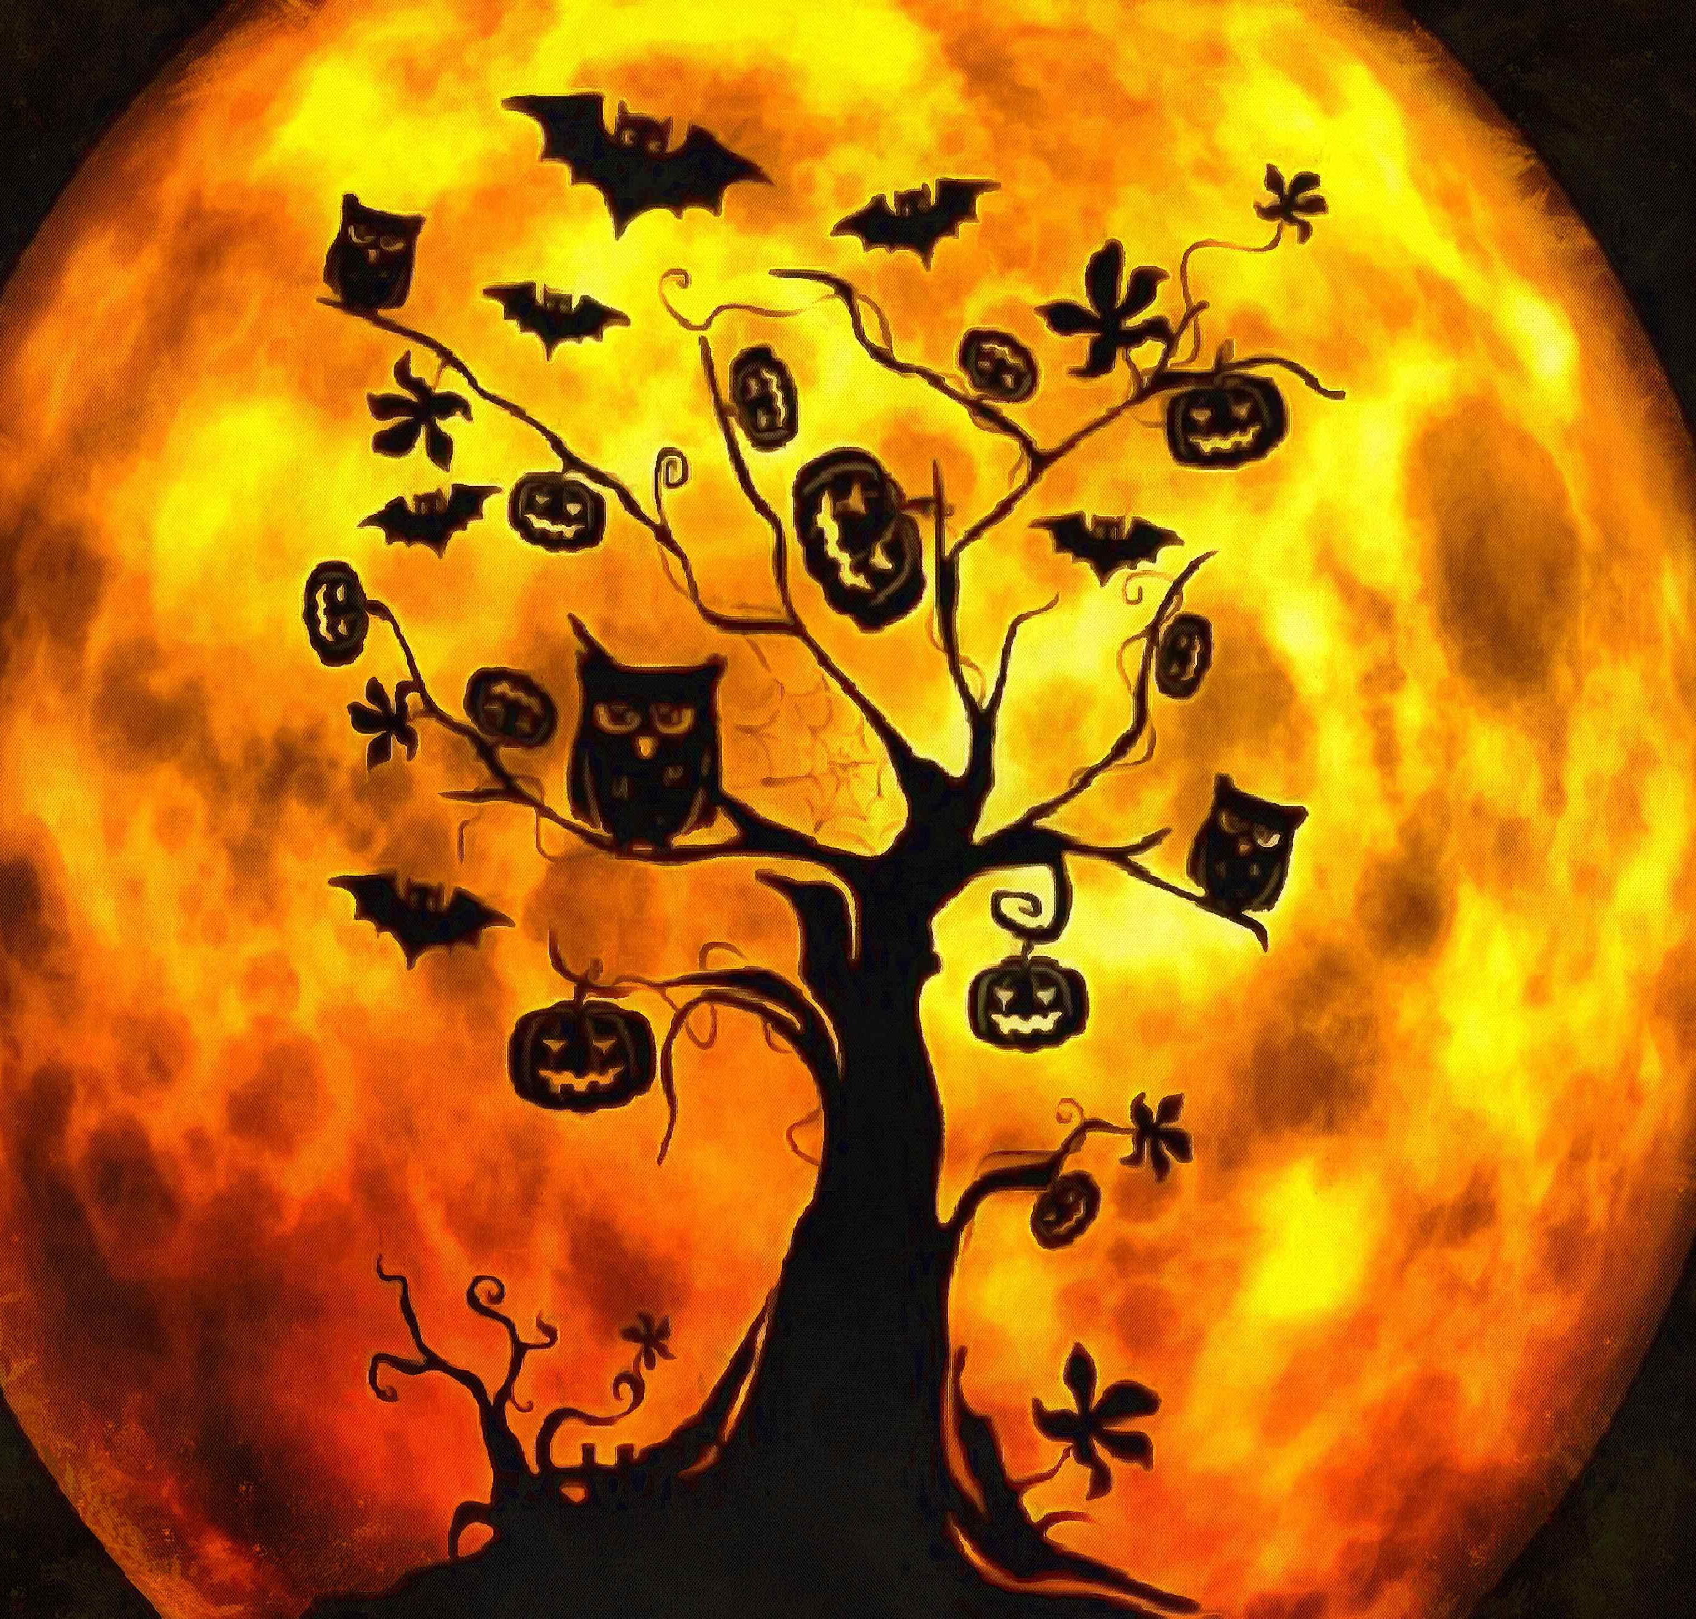
Have a wonderful Halloween mid-term break…see you on the 2nd November!

